Slide 1

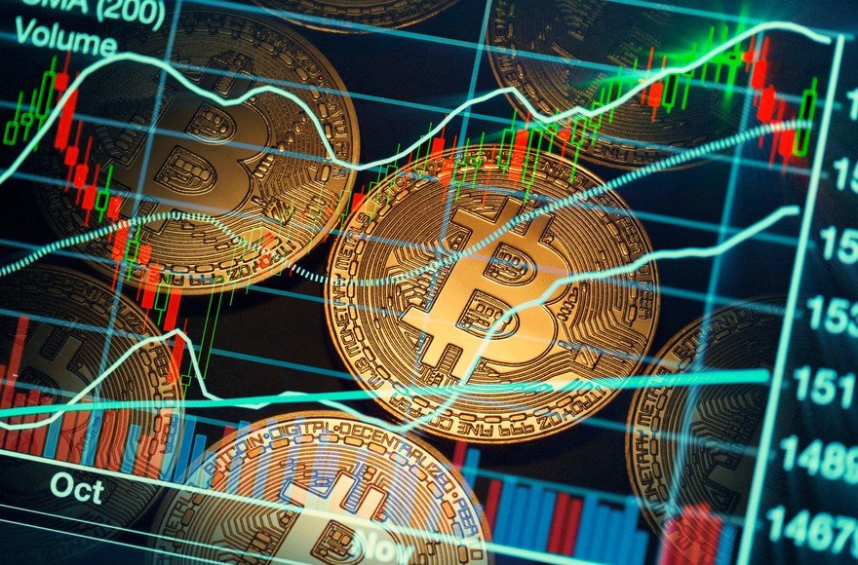
Cryptocurrency Analysis Using Power BI
Cryptocurrencies have emerged as a transformative force in the financial landscape, offering a decentralized and secure alternative to traditional monetary systems. This presentation will provide a detailed overview of the cryptocurrency market and leverage the power of Power BI to analyze and forecast trends in this rapidly evolving space.

Slide 2

Introduction to Cryptocurrencies
Cryptocurrencies are digital assets that utilize cryptography for secure transactions and the creation of new units. They operate on a decentralized network, eliminating the need for a central authority or intermediary. This unique structure has made cryptocurrencies increasingly significant, as they offer users greater control, transparency, and accessibility in financial transactions.
The objective of this project is to analyze and forecast cryptocurrency trends using the powerful data visualization capabilities of Power BI. By delving into the historical data and market dynamics, we aim to uncover valuable insights that can inform investment decisions and strategic planning in the cryptocurrency space.

Slide 3
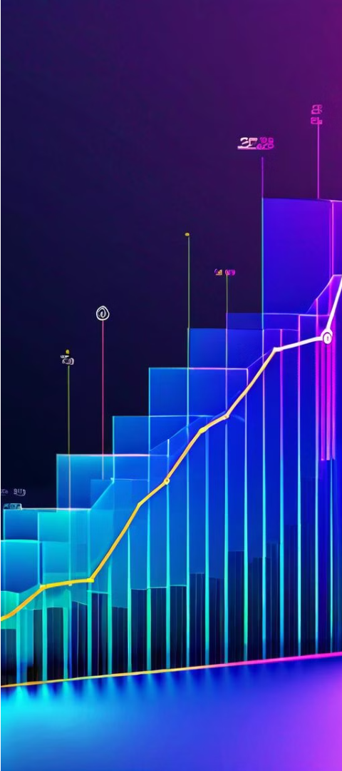
Binance Coin 2021 Overview
1
Market Cap
The market capitalization of Binance Coin reached an impressive $8.58 trillion in 2021.
2
Trading Volume
The trading volume for Binance Coin amounted to a staggering $664 billion during the year.
3
Price Movements
Binance Coin experienced a wide range of price fluctuations, with a high of $690.93 and a low of $35.17. The average price throughout the year was $296.49.

Slide 4
Comprehensive Cryptocurrency Data (2013-2021)
Market Cap
$504 trillion
Trading Volume
$54 trillion
Highest Price
$64,860
Average Price
$1,230
Lowest Price
$0.00

Slide 5




Major Cryptocurrencies Analyzed
Bitcoin
Ethereum
Dogecoin
Binance Coin
The pioneering cryptocurrency, known for its decentralized nature and limited supply.
A blockchain platform that enables the development of decentralized applications.
A lighthearted cryptocurrency that has gained significant popularity and attention.
The native token of the Binance cryptocurrency exchange, used for trading and platform fees.

Slide 6
Bitcoin 2021 Forecasting
Max Market Cap
Min Market Cap
Forecasting
The maximum market cap for Bitcoin is projected to reach $1 trillion.
The minimum market cap for Bitcoin is forecasted to be $546 billion.
The overall forecasting for Bitcoin's market cap is $850 billion.

Slide 7
Overall Market Forecasting
Max Market Cap
Min Market Cap
Forecasting
The maximum market cap for the overall cryptocurrency market is projected to reach $1 trillion.
The minimum market cap for the overall cryptocurrency market is forecasted to be $771,000.
The overall forecasting for the cryptocurrency market as a whole is $30 billion.

Slide 8
Key Insights and Trends
1
Significant Growth
2
Volatility and Fluctuations
3
Emerging Trends
The rise of altcoins, the increasing institutional adoption, and the growing popularity of decentralized finance (DeFi) are some of the key trends shaping the cryptocurrency landscape.
The cryptocurrency market has experienced remarkable growth, with the total market capitalization reaching unprecedented levels.
Cryptocurrencies have exhibited high levels of volatility, with significant price fluctuations observed across different assets.

Slide 9

Conclusion and Future Work
This comprehensive analysis of the cryptocurrency market using Power BI has provided valuable insights into the current state and future prospects of this rapidly evolving industry. The findings highlight the significant growth, volatility, and emerging trends that characterize the cryptocurrency landscape.
Moving forward, further research and analysis could delve deeper into the factors driving cryptocurrency adoption, the impact of regulatory changes, and the potential applications of blockchain technology beyond the financial sector. By continuously monitoring and analyzing the cryptocurrency market, we can better understand its dynamics and make informed decisions in this dynamic and transformative space.
Thank you for your attention. If you have any questions or would like to discuss this analysis further, please feel free to reach out to me at LinkedIn https://www.linkedin.com/in/hassan-shaikh-2435602a8/

